Slide 1
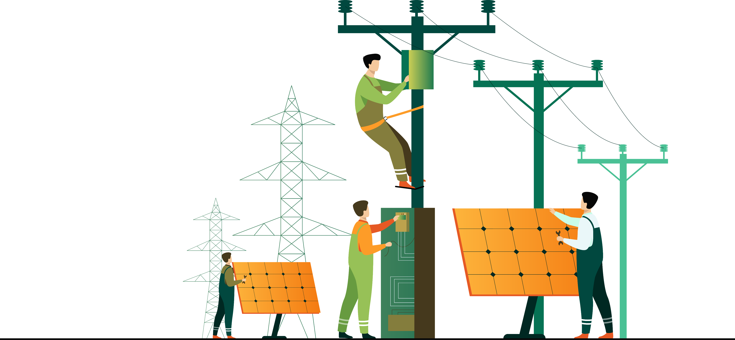
Electrical Fault Generation and Classification in the
Northern Region of Bangladesh
Prepared By
Samia Akter 1906151
Md. Aktarujjaman Swan 1906152
Md. Asif Kabir 1906153
Tamim Hasan Bhuyian 1906154
Md. Shipon Hossain 1906155
Shourov Joarder 1906156

Slide 2

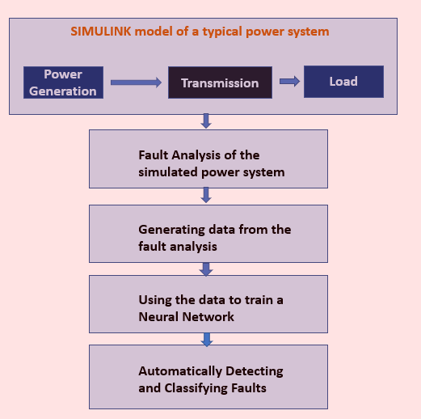


Initial Planning

Slide 3

Types of Faults in Transmission Line
Common reasons for fault occurrence
Lightning
Wind
Manufacturing defects
Types of electrical faults
LLL - Line-Line-Line fault
Three-Phase fault where all three lines are faulted
LG - Line-to-Ground fault
Fault where one line comes into contact with the ground
LL - Line-to-Line fault
Fault where two lines come into contact with each other
LLG - Line-to-Line-to-Ground fault
Fault where two lines come into contact with each other and also with the ground

Slide 4
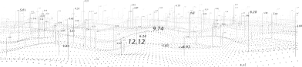
Fault Detection and Classification Techniques
Traditional methods
Overcurrent relays
Differential relays
Distance relays
Advanced methods
Machine learning
Deep learning

Slide 5
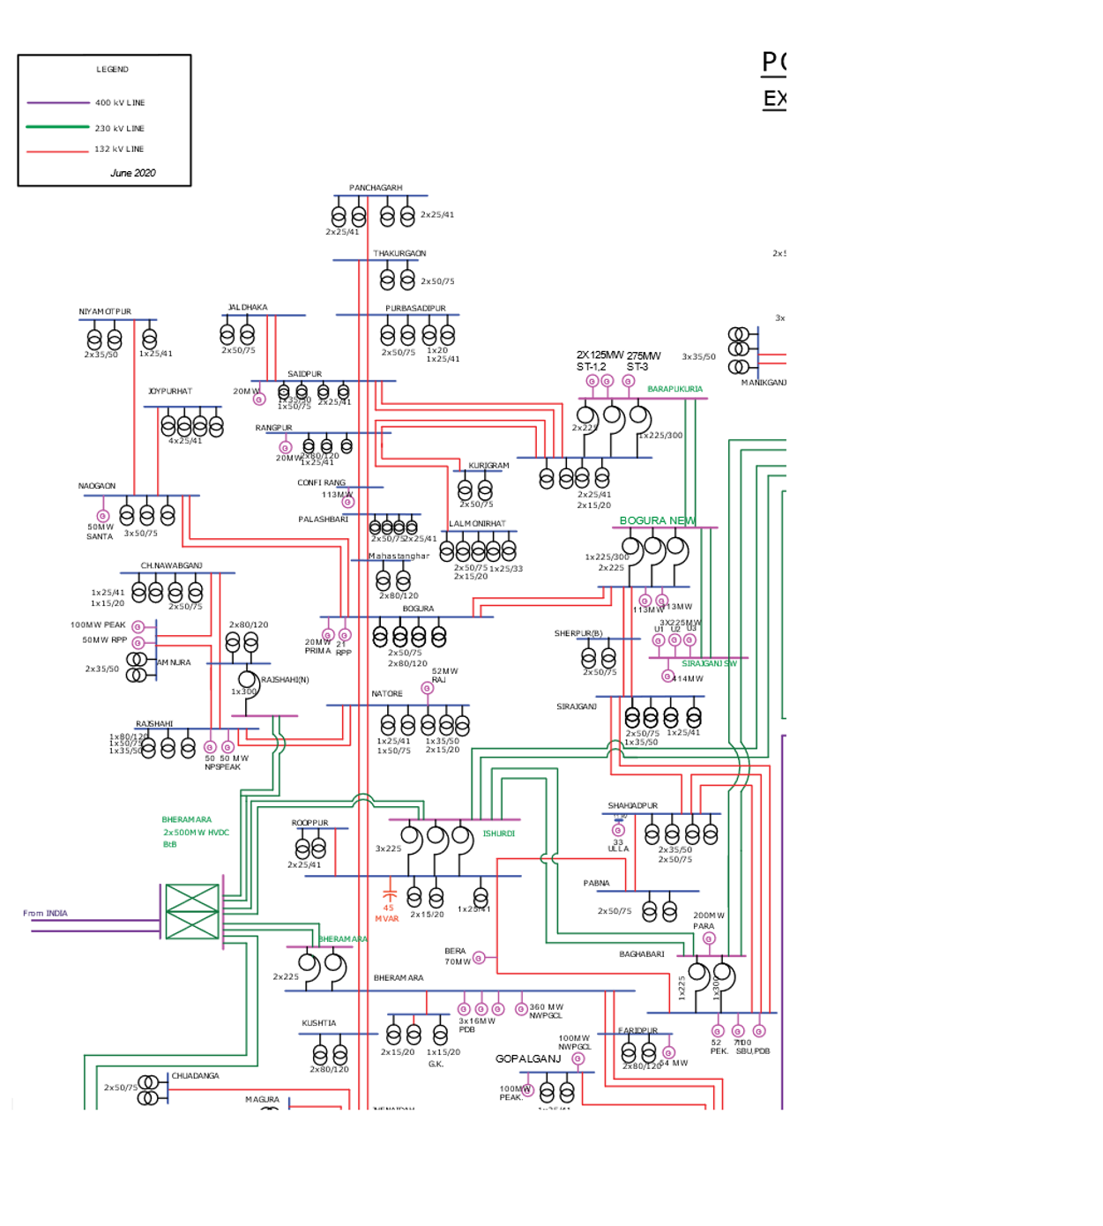


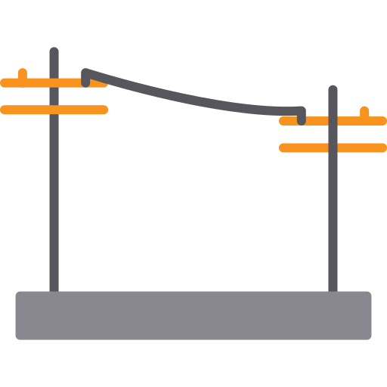
Study Area
The Northern Region of Bangladesh
Fault Analysis in the Northern Region of Bangladesh.
Focus on the north region of Bangladesh for fault analysis.
Total 35 buses in the region
MATLAB Simulink model development with
35
buses
30
generators
94
transformers
Transmission
line

Slide 6
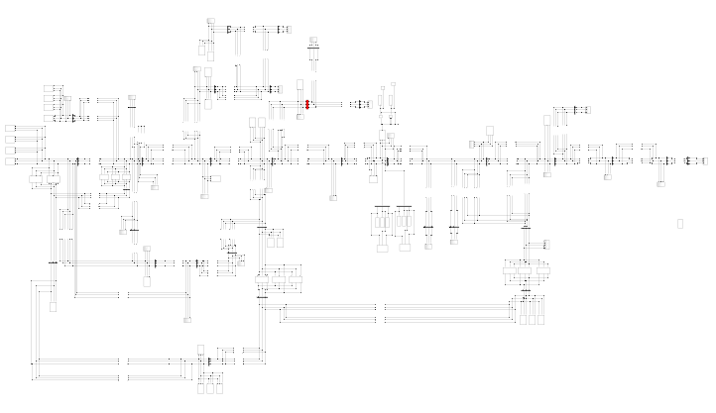
Simulink Model of The Study Area

Slide 7
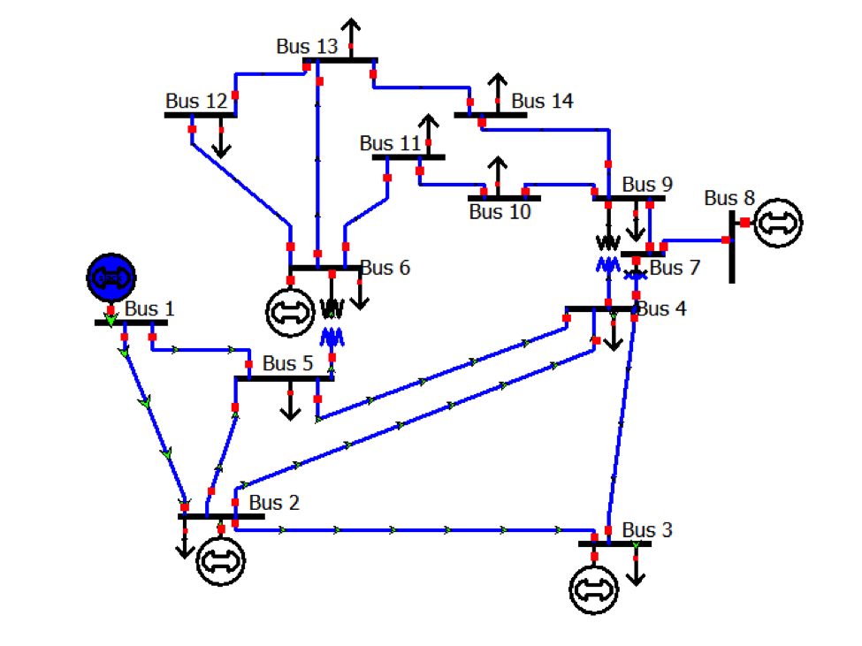
IEEE 14 Bus
MATLAB Simulink model development with
14
buses
5
generators
2
transformers
Transmission
line
Courtesy:
Illinois Center for a Smarter Electric Grid (ICSEG)

Slide 8
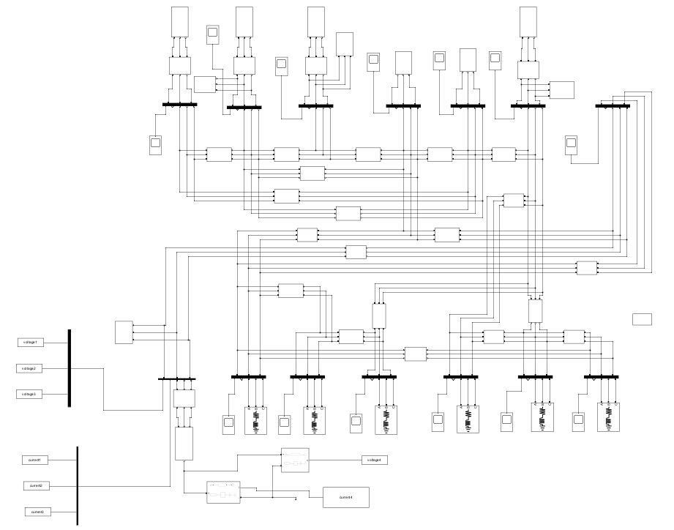
14 Bus Simulink Model

Slide 9
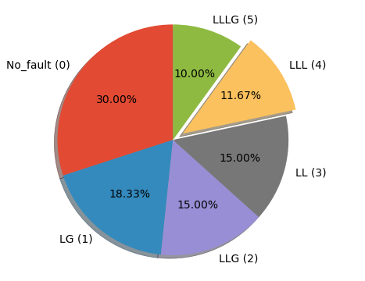
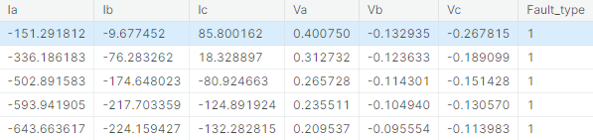
Data and Fault Classification Method
Total Data Generated : 76
Each Sample : 6 time series data with 100 samples
Time Series Data

Slide 10
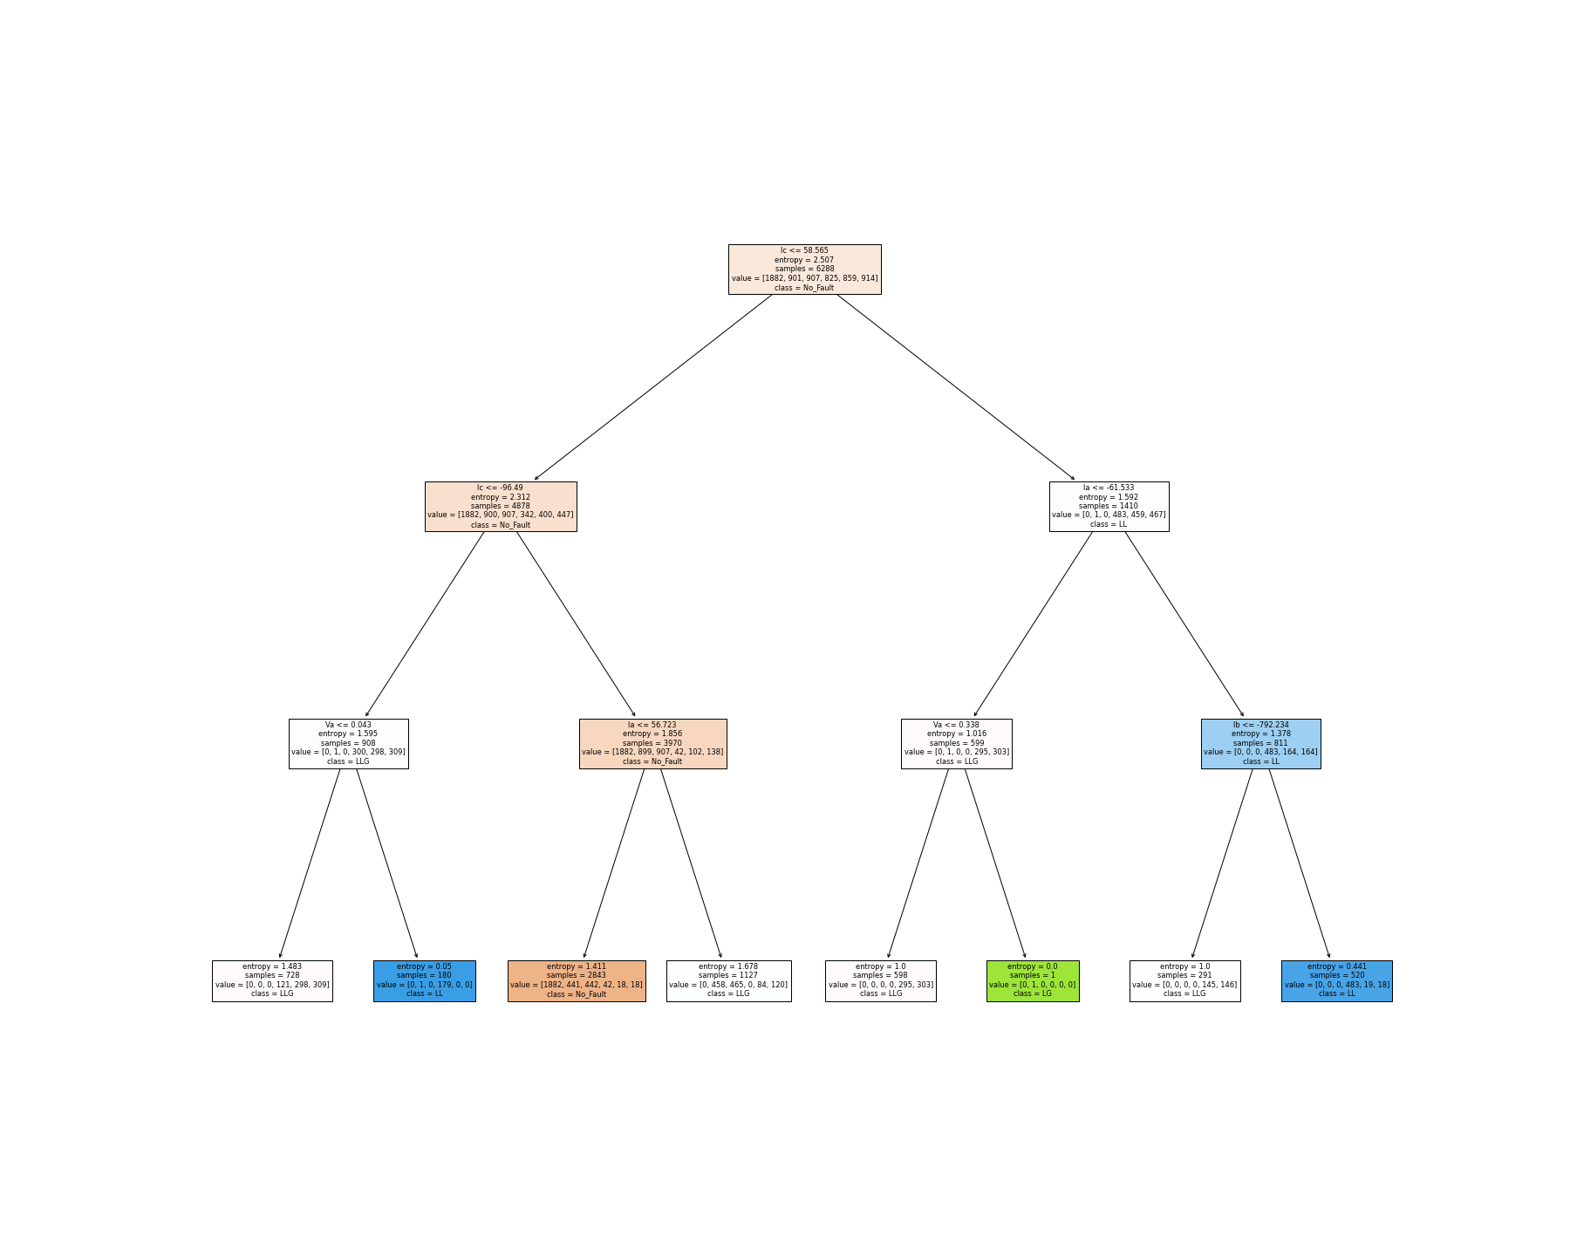
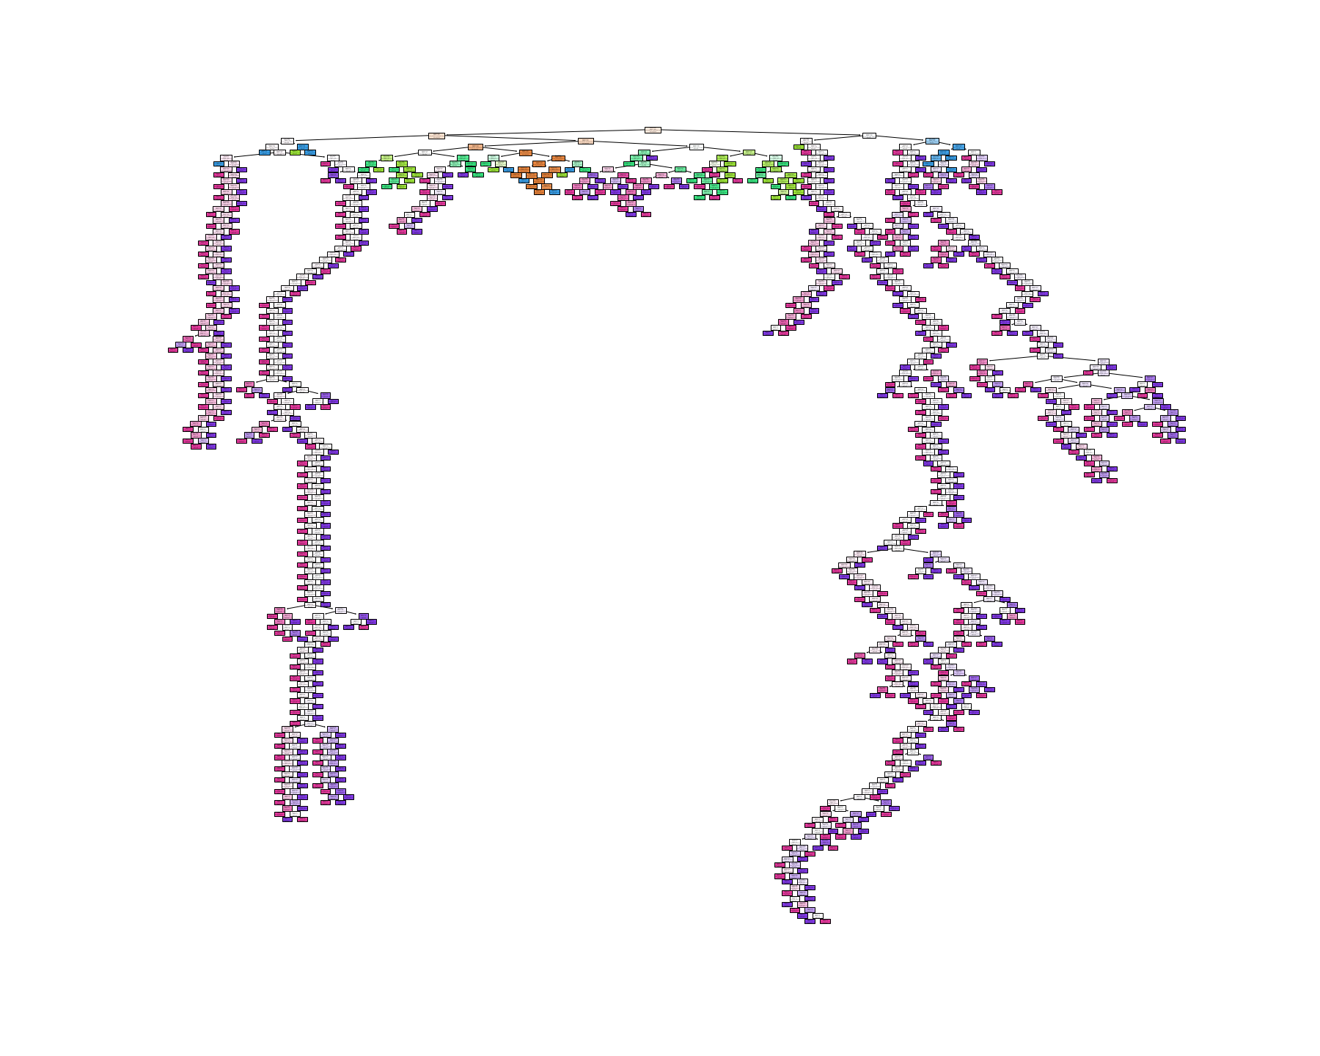
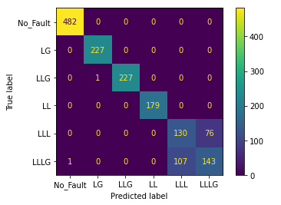
Machine Learning Method
Decision tree Classifier
Results & Conclusion
Accuracy of the Training dataset is : 100.0 %
Accuracy of the validation dataset is : 88.239033%

Slide 11
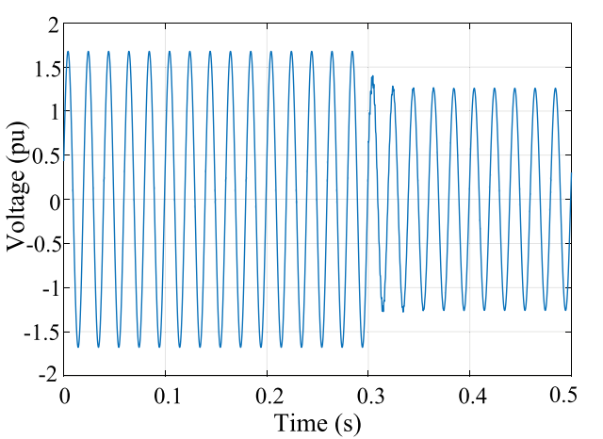
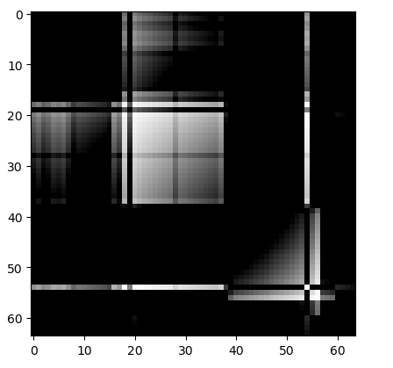
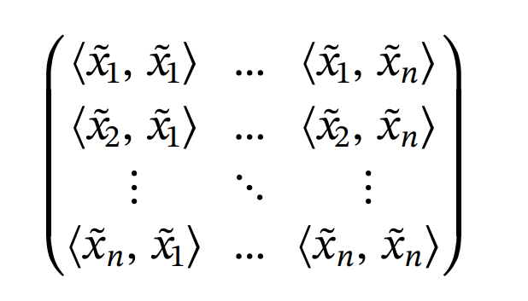
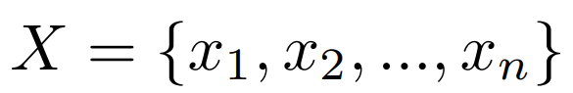
Deep Learning Method
Feature Extraction
GAF
Transformation
Gramian Angular Field (GAF) Transformation
<

Slide 12







CNN Architecture
2 Conv
Max Pool
2 Conv
Max Pool
Max Pool
2 Conv
3 Conv
16x16x64
16x16x128
8x8x128
64x64x3
64x64x32
32x32x32
32x32x64

Slide 13






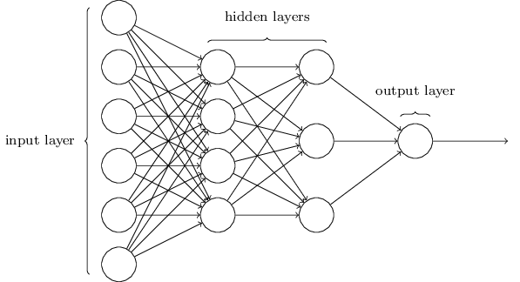
Model Architecture
CNN Model
CNN Model
CNN Model
CNN Model
CNN Model
CNN Model

Slide 14
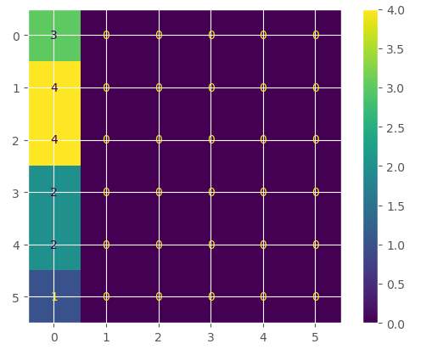
Results & Conclusion
Validation loss is 2.087895393371582
Accuracy of the validation data is 18.75%

Slide 15
Future Prospect
Computational Power
Research Paper
Benefit PGCB for Faster Fault Classification

Slide 16

References
Mother Paper : https://www.sciencedirect.com/science/article/pii/S037877962030242X
Initial Resource : https://www.kaggle.com/datasets/esathyaprakash/electrical-fault-detection-and-classification

Slide 17
THANK YOU

